Slide 1

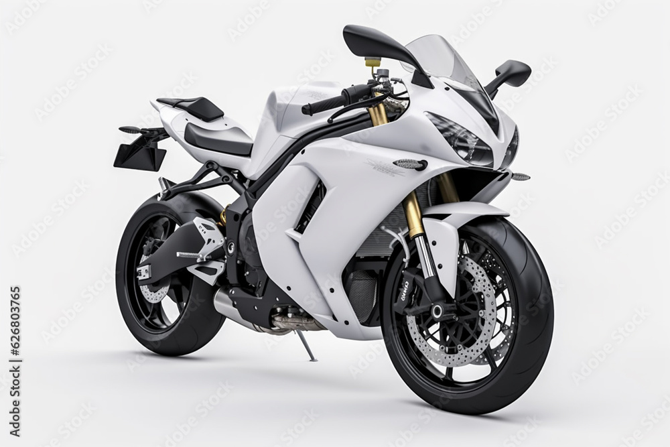
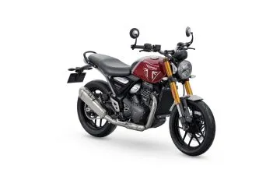
BIk
Trivalley Bike Store
Classification Analysis

Slide 2
Content
Business Case – To identify the features impacting the Bike_Buyer of Trivalley Bike Store
Data Acquisition –Customer information and their yearly incomes are provided in CSV format.
Data Preparation – Missing data was found using Azure ML and steps were taken to fill the gaps
Data Visualization – Graphs were created using Tableau understand the relation of feature to the Bike_Buyer.

Slide 3
Data Preparation
Total number of records = 16519
98 duplicate records were found and the duplicate rows are removed from the dataset.
The number of records(without duplicates)=16421
Following missing values were found:
Title (number of missing records=16431)
Middle name(number of missing records=6985)
Suffix(number of missing records=16517)
Address line2(number of missing records=16243)
Missing values treatment:
The features with high missing values percentage are ignored from the analysis.

Slide 4
Exploratory Data Analysis
The Features (i.e., variables) are segregated into three Categories namely:
Dependent Variable (Y) – This is the Bike_Buyer which is to be predicted
Noise Features : Variables which would not have a significant impact on the value of Bike_Buyer.
Redundant
Feeder variables
Predictor Variables : Variables which were considered to have an impact on the Bike_Buyer.

Slide 5
Exploratory Data Analysis (contd..)
Noise Variables
Predictor Variables
Customer ID
First Name
Last Name
AddressLine1
Phone Number
Birth Date
Education
HomeOwnerFlag
AveMonthSpend
Gender | MaritalStatus
Occupation | NumberCarsOwned
City | NumberChildrenAtHome
StateProvinceName | TotalChildren
CountryRegionName | YearlyIncome
PostalCode

Slide 6
Data Visualization
Data visuals are created using Tableau where charts are plotted using the independent variables against the dependent variable (Bike_Buyer).
These charts help us in getting a preliminary idea about the relationship between the independent variables and the dependent variable (Bike_Buyer).

Slide 7
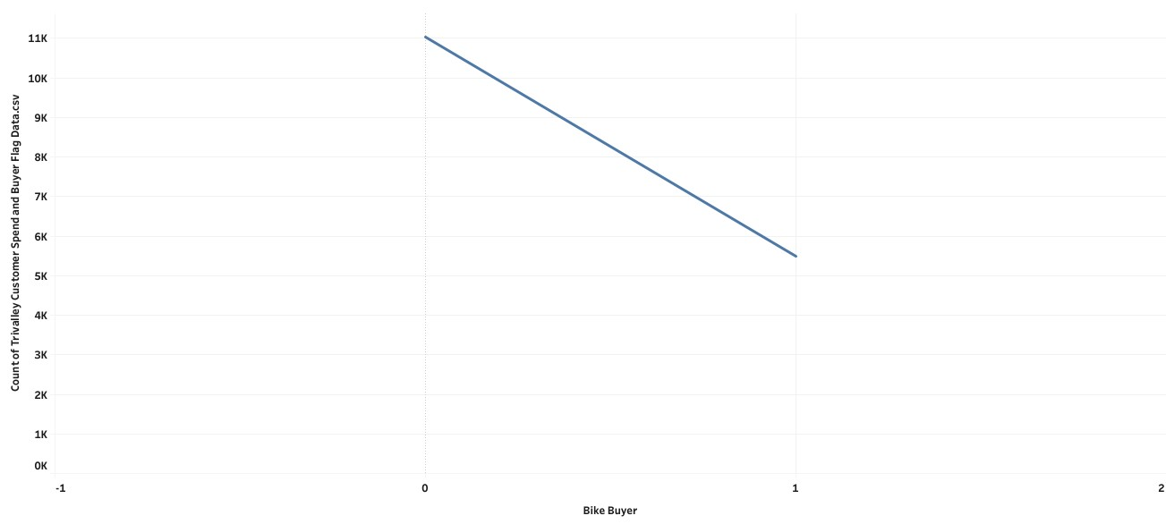
Bike Buyer
BIKE _BUYER
categories
Count %
Yes(1) 5457 33.23%
No(0) 10964 66.77%
Key Highlights
The data consists of 16421 customers.
Out of 16421 customers ,66.77% or 10964 of them are not Bike Buyers( Indicates as 0).
Out of 16519 customers,33.23% or 5457 of them are Bike Buyers( Indicated as 1).

Slide 8
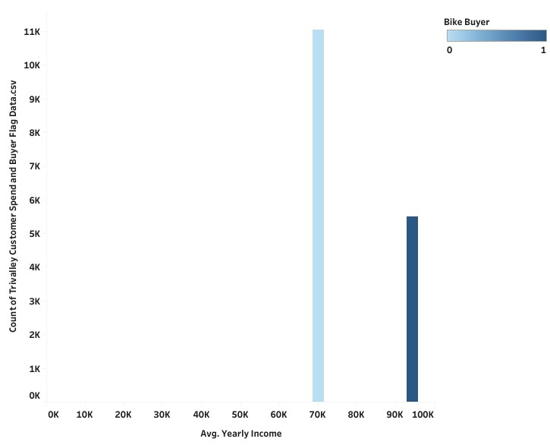
Average yearly Income Vs. Bike_Buyer
Key Highlights
Out of 16421 customers,66.77% or 10964 are Non Bike Buyers with the average Yearly Income 70081
Out of 16421 customers ,33.23% or 5457 are Bike Buyer with the average Yearly Income 94282..

Slide 9
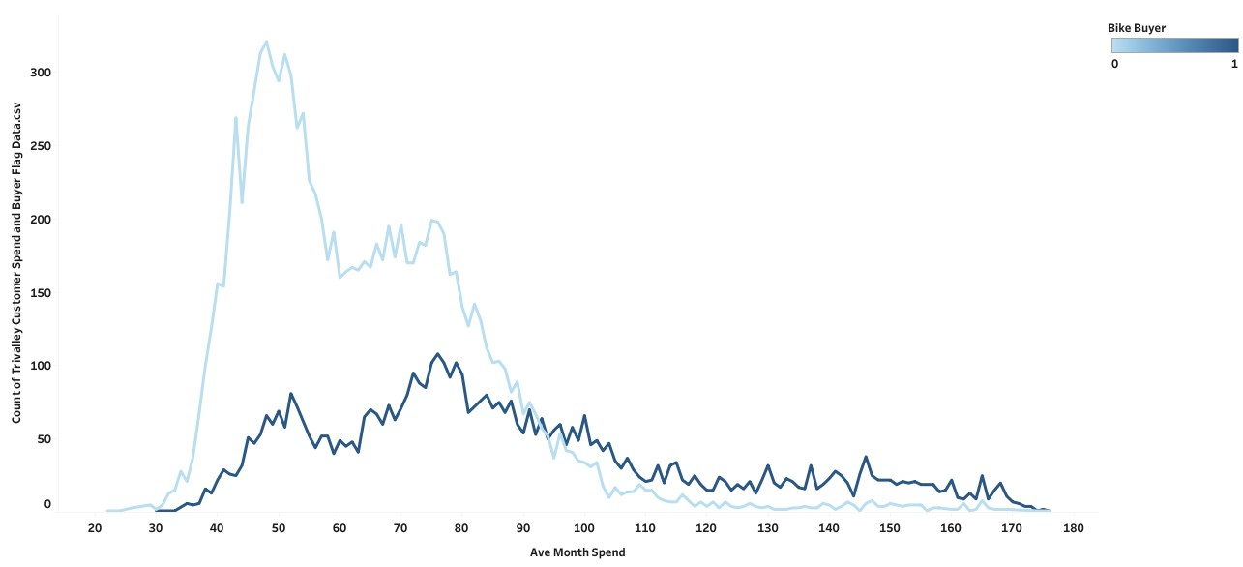
Average Month Spend Vs. Bike_Buyer
Key Highlights
Out of 16421 Customers , maximum no.of Bike_Buyers would spend in range 40000 to 70000.
Out of 16421customers, maximum no.of Non_ Bike Buyers would spend in range 20000 to 48000.

Slide 10
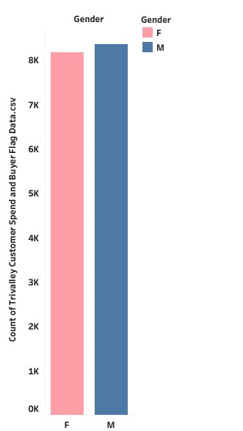
Gender
CATEGORIES
count %
Female 8120 49.449%
Male 8301 50.551%
Key Highlights
The data consists of 16421 customers
Out of 16421 customers , 49.449% or 8120 were Females.
Out of 16421 customers , 50.551% or 8301 were Males.

Slide 11
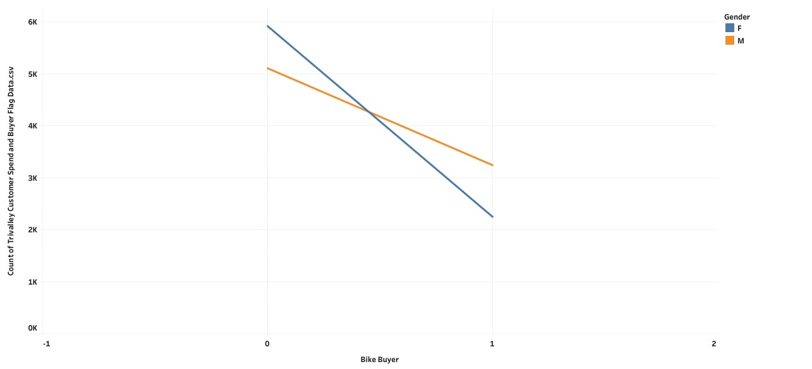
Gender Vs. Bike_Buyer
Bike _Buyer Count
Gender Yes(1) No(0) Totals
Female 2233 5887 8120
Male 3224 5077 8301
Key Highlights
Out of 50.554% Males, 30.92% or 5077 were not Bike_Buyers(0) and 19.63% or 3224 were Bike_Buyers(1).
Out of 49.446% Females,35.85% or 5887 were not Bike_Buyers(0) and 13.60% or 2233 were Bike_Buyers(1).

Slide 12
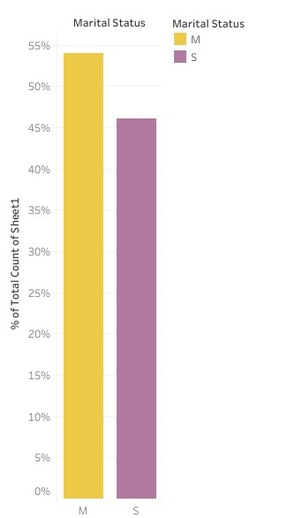
Marrital Status
CATEGORIES
Count %
Married 8864 53.980%
Single 7557 46.020%
Key Highlights
The data consists of 16421 Customers of which 8864 or 53% were Married and 7557 or 46% were Singles.

Slide 13
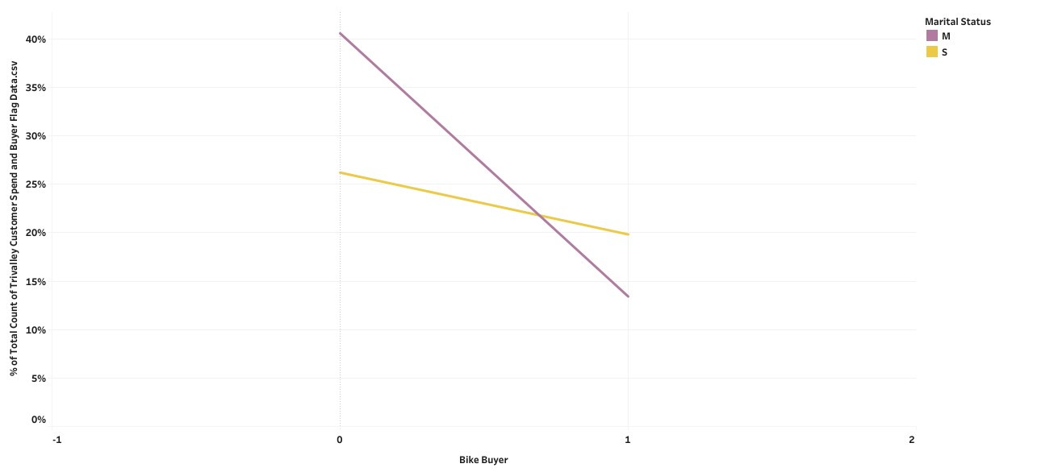
Marital Status Vs. Bike_Buyer
Bike _Buyer Count
Yes(1) No(0) Total
Marital Status
Married 2200 6664 8864
Single 3257 4300 7557
Key Highlights
Out of 53.980% Married Customers , 40.58% or 6664 were not Bike_Buyers(0) and 13.40% or 2200 were Bike_Buyers(1).
Out of 46.020% Single Customers,26.19% or 4300 were not Bike_Buyers(0) and 19.83% or 3257 were Bike_Buyers(1).

Slide 14
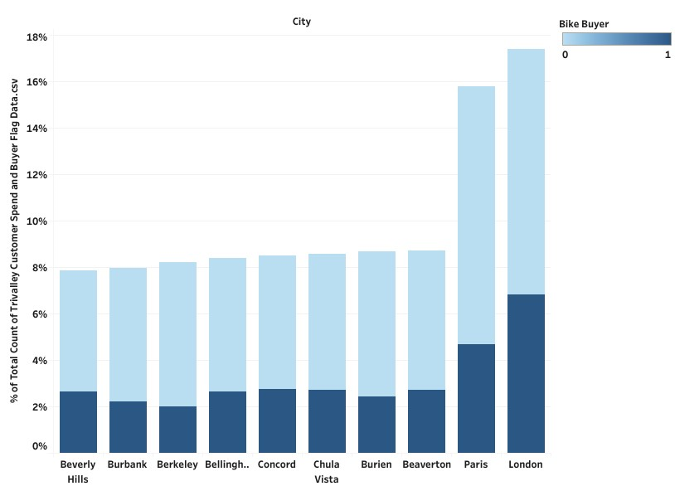
Top Ten Cities and Bike_Buyer Status
Key Highlights
London has 6.866% of Customers were Bike_Buyers(1) and 10.599% of were not Bike_Buyers(0).
Beverly Hills has 2.627% of customers were Bike_Buyers(1) and 5.207% were not Bike_Buyers(0).

Slide 15
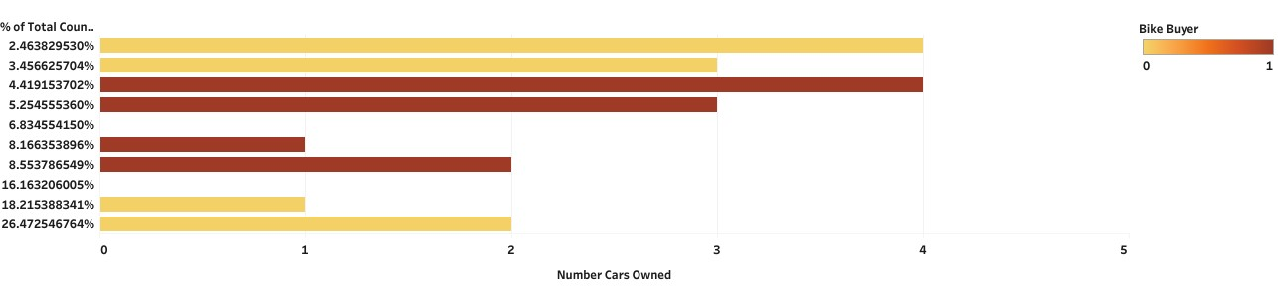
Number of Cars and Bike_Buyer
Out of 16421 customers, 18.22%or 2992 have 1 car and they are not Bike Buyer.
Out of 16421 customers ,2% or 404 have owned 4 cars and indicated as not Bike Buyer.
Out of 16421 customers,8% or 1341 have owned 1 car and they are Bike Buyers.
Out of 16421 customers, 4% or 723 have owned 4 cars and they are Bike Buyers.
Key Highlights

Slide 16
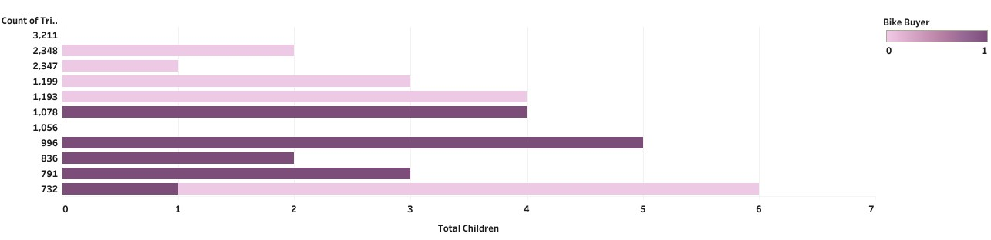
Relationship between Total Children and Bike_Buyer
Out of 16421 customers,19.46% or 3196 were have 0 children and indicated as Non Bike_Buyer.
Out of 16421 customers,6.41% or 1053were have 0 children and indicated as Bike _Buyer
out of 16421 customers,6.02% or 988 have 5 children and indicated as Bike _buyer.
Out of 16421 customers ,4.43% or 727 have 5 children and indicated as non Bike_Buyer.
Key Highlights

Slide 17
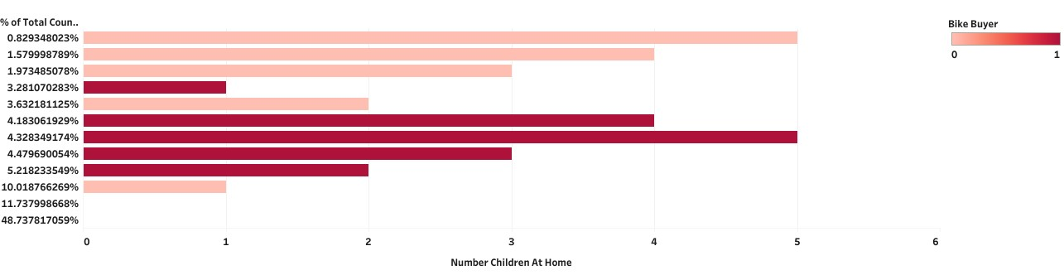
Number of Children At Home and Bike_Buyer
Key Highlights
Out of 16421 Customers,48.75% or 8005 have 0 children at home and not a Bike_Buyer.
Out of 16421 customers,11.75 % or 1929 have 0 children at home and were indicated as Bike_Buyer.
Out of 16421 customers ,1% or 136 have 5 children at home and were indicated as non Bike_Buyer.
Out of 16421 customers,4% or 709have 5 children at Home and were indicated as Bike_Buyer.

Slide 18
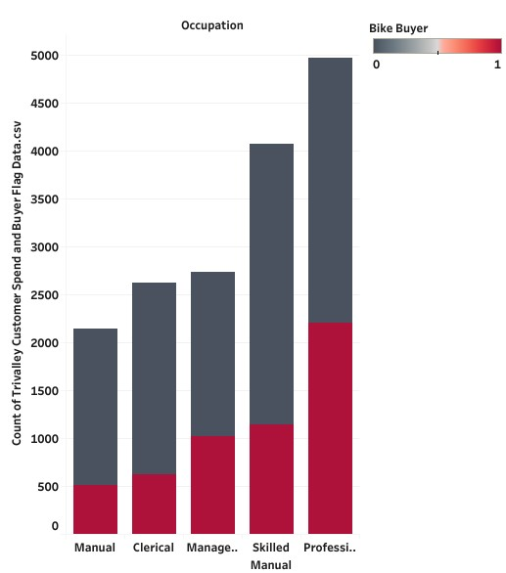
Relationship between Occupation and Bike_Buyer
Out of 16421cutomers,3.07% or 504 of them are manual workers and are Bike_Buyers.
Out of 16421Customers, 13.31% or 2185 of them have Professional workers and are Bike_Buyers.
Key Highlights

Slide 19
High School Chi-Squared Test Analysis
Chi-Squared Test Analysis was performed to identify list of features which impact the std score
Top Numerical features impacting the average month spend
AveMonthSpend | Yearly Income
Top Categorical features impacting Average Month Spend
Independent Variable
Number of Children at home
Marital Status
Number cars owned
Independent Variable
Occupation
Gender
Total Children

Slide 20
High School Linear Correlation Ratio Tests Analysis
Top 3 categorical features Influencing factors on Bike_Buyer of Trivalley Customers are : Number Of Children At Home, Marital Status, Number Cars Owned.
Independent Variable | Correlation Ratio
Number of Children At Home | 0.08
Marital Status | 0.03
Number Cars Owned | 0.02
Total Children | 0.02
Occupation | 0.01
Gender | 0.01

